Slide 1
Gas Welding and Types of Flame
Lecture 9

Slide 2
Gas Welding Equipment
Gas cylinders
Hose pipes and valves
Cylinder pressure gauge
Outlet pressure gauge
Pressure regulators
Blow pipe or torch and spark lighter
Welding screens & goggles
Gloves and apron
Wire brush, trolley, chipping hammer

Slide 3
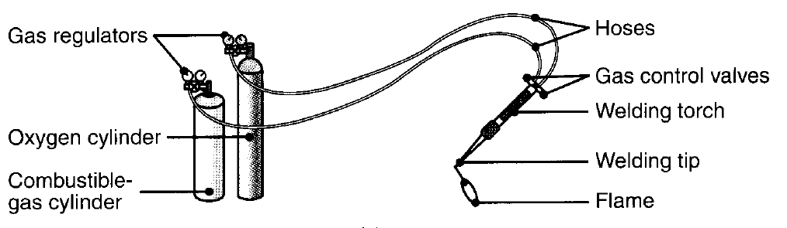
Gas welding equipment [3]
Gas Welding Equipment

Slide 4
Gas Welding Equipment: Gas Cylinders & Regulators
Gas Cylinders:
Oxygen gas cylinder is painted black colour and acetylene cylinder in maroon or red colour. Oxygen is filled at pressure to 2000 PSI.
Acetylene is kept dissolved in acetone in Maroon Cylinder. It is highly recommended that for safety reasons acetylene cylinder should not be exposed to higher temperature. Both the cylinders are made with different types of threads (Left hand and Right hand).
Pressure Regulators:
Each cylinder is fitted with Pressure regulator that maintains supply pressure at a constant value. Supply pressure can be controlled and maintained to different values as required.

Slide 5
Gas Welding Equipment: Pressure gauges & Valves
Pressure Gauge:
Pressure gauge measures the pressure with respect to the atmospheric pressure. Two pressure gauges are mounted on each of the cylinders. One for cylinder pressure and second for supply pressure.
Hose Pipes & Control Valves:
Hose pipes are used to carry gases from their respective cylinders to blow pipe. The Colour codes of hose pipe are same as cylinders. Hose pipes are made of good quality rubber for long life. Each cylinder is mounted with valves to control the flow of oxygen and acetylene separately, to get desired flame.

Slide 6
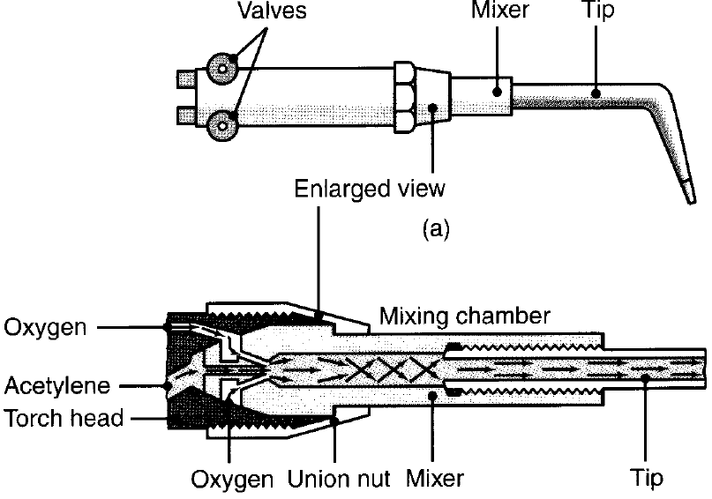
Gas welding torch [3]
Gas Welding Equipment: Torch
Gas welding torches are low pressure torches and Gas cutting torches are high pressure torches.
Both the gases are mixed in a chamber of the torch and then flow out through the nozzle and burnt by spark lighter.
Gas cutting torch has holes for flow of mixture of gases at the periphery and a separate oxygen flow hole at the centre.

Slide 7
Oxy Acetylene Gas Welding
In oxy – acetylene welding heat is generated as a result of chemical reaction. The primary combustion process occurs in the inner core of the flame involves the following reaction:
This reaction consists of the further burning of both the hydrogen and the carbon monoxide and produces about two-thirds of the total heat.
The temperatures developed in the flame is 3300°C approx.

Slide 8
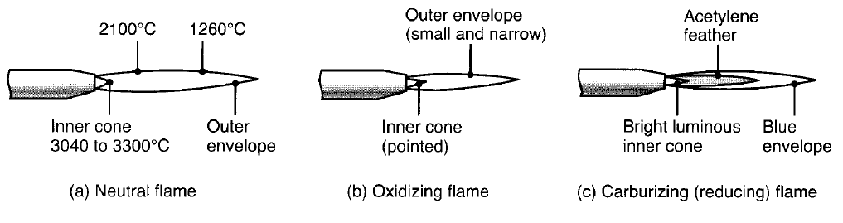
Types of Gas Welding Flames
Types of gas welding flames [3]

Slide 9
Types of Gas Welding Flames
Neutral Flame:
When equal amount of Oxygen and Acetylene are mixed and burnt at the outlet of welding torch, A neutral flame is obtained. As in fig of previous slide this type of flame is made of two sharply defined zones i.e. inner white flame cone and outer envelope of blue colour.
Carburizing Flame:
This flame is consists of three zones the inner cone, an outer envelope as same in case of neutral flamed and middle zone surrounds inner cone extended to outer envelope. It’s size increases with increased quantity of Acetylene.

Slide 10
Types of Gas Welding Flames
Oxidizing Flame:
Excess mount of the Oxygen in the mixture will produce this flame. Oxygen to Acetylene ratio varies between1.15 to 1.50. The inner cone is relatively shorter and excess oxygen turns the flame to light blue colour. It burns with a harsh sound.

Slide 11
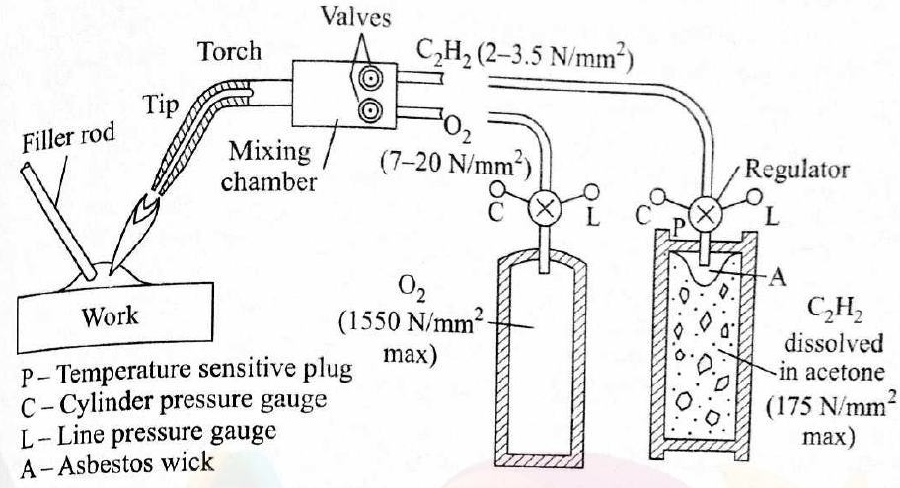
Gas Welding Process
Schematic diagram of Gas welding process [1]

Slide 12
Gas Cutting
Gas cutting or flame cutting is an exothermic oxidation of the steel being cut.
The material is preheated by an oxy-fuel gas flame around 900°C.
The gas cutting nozzle has an outer ring of holes through which the preheating gas mixture is delivered and a central hole through which only oxygen gas flows.
The exothermic oxidation of steel forms a fluid slag of iron oxide and the metal section is pierced. Molten metal carried away from the cut by the oxygen stream leaving a cut. Movement of the cutting torch across the work piece cuts a continuous slot.
Usually steel sections up to 300 mm thick are easily cut.

Slide 13
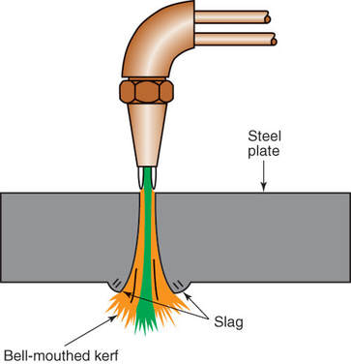
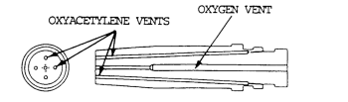
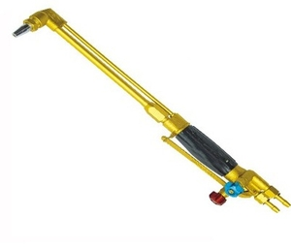
Gas Cutting Torch and Operation
Gas cutting torch and operation

Slide 14
References / Further Readings
[1] Ghosh, A. & Mallik, A.K.; Joining processes, Manufacturing Science, Latest edition.
[2] https://www.sciencedirect.com/topics/engineering/gas-welding
[3] Kalpakjian, S & Schmid, S,; Manufacturing Processes for Engineering Materials, Latest edition.

Slide 15


